Slide 1
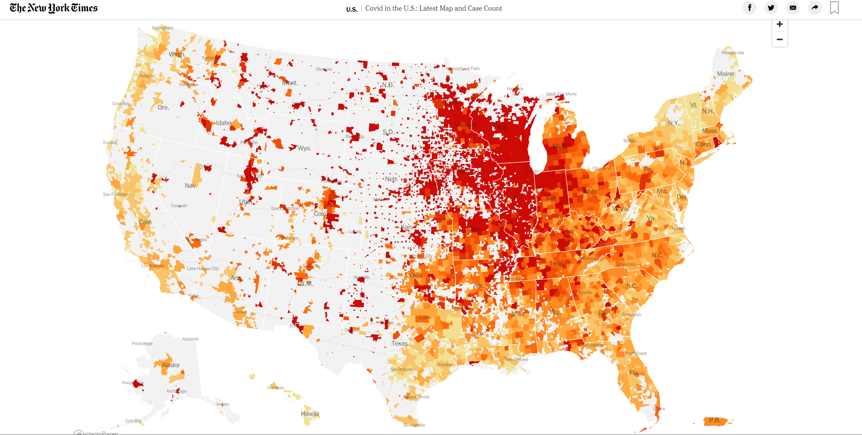
Confirmed Covid19 Cases per Capita in the US (11/09/2020)
Today, 11/09/2020
The US overpassed 10 million Covid19 confirmed cases!!
3% of the total population
Team Members:
Anna Rischitelli
Priya Arunachalam
Nataliia Sokolova
Vincent Durcan
Shadia Duery

Slide 2



Do rates of Covid19 differ based on State policies implemented?
Comparison between California and Texas
Notes:
Hypothesis: Stronger policies reduce the rates of COVID19 spread
Data Sources:
-John Hopkins University Covid19 data
-USA.gov land survey
- NY Times
- CA and TX Health Government websites (policy implementation)

Slide 3
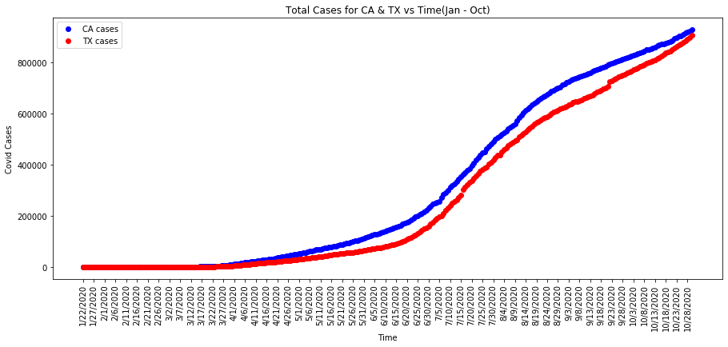
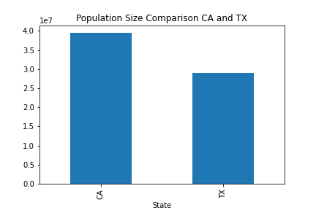
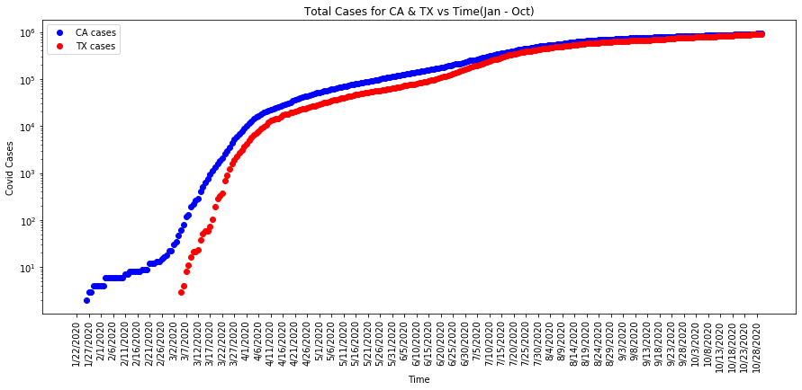
Number of total confirmed Covid19 cases in CA and TX from Jan-Oct 2020

Slide 4
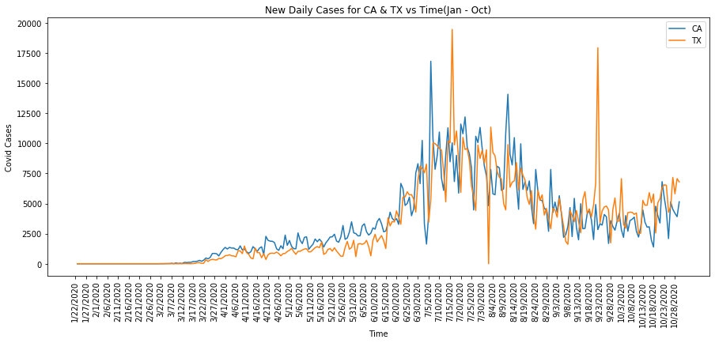
Number of new daily confirmed Covid19 cases in CA and TX from Jan-Oct 2020

Slide 5
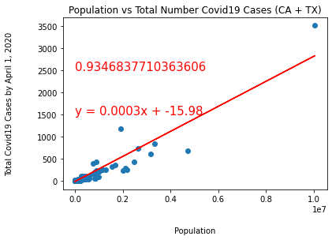
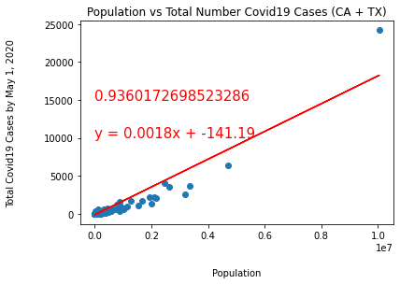
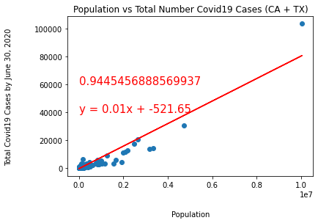
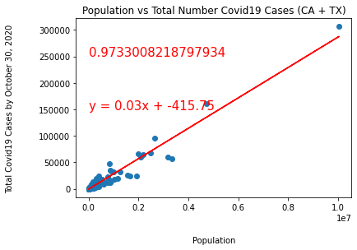
Exploratory Data Analysis: Total Confirmed Cases Related to Population Size
April 1,2020
May 1,2020
June 30,2020
October 30,2020

Slide 6
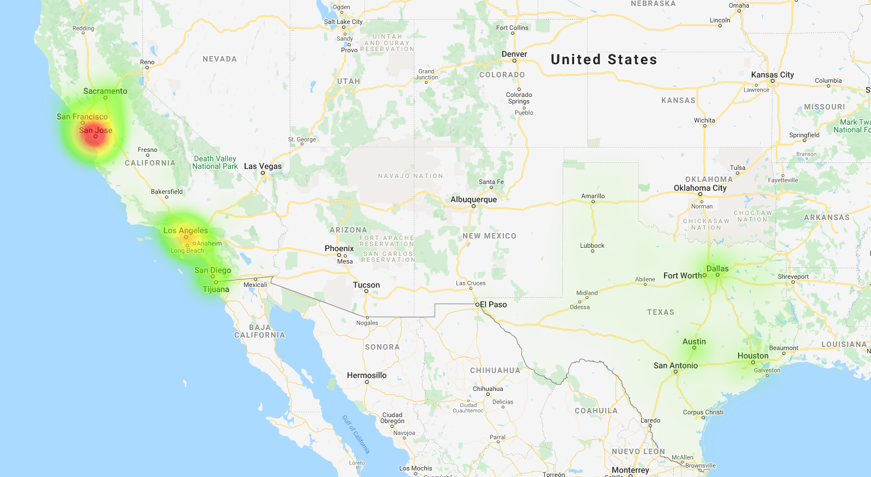

March 18, 2020

Slide 7
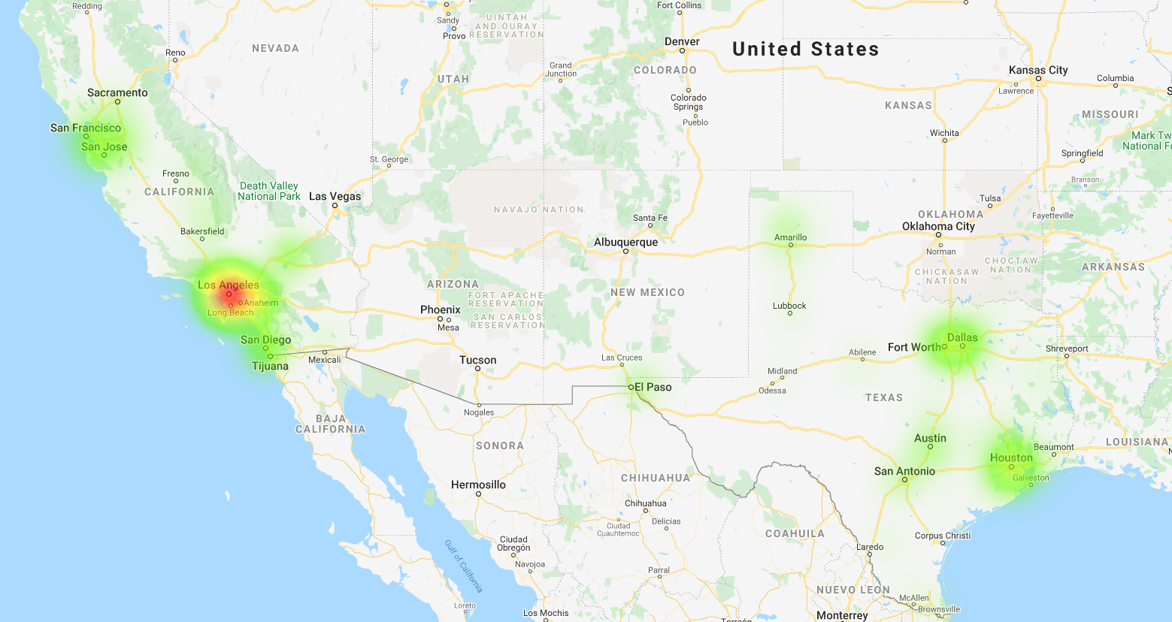
April 29, 2020

Slide 8
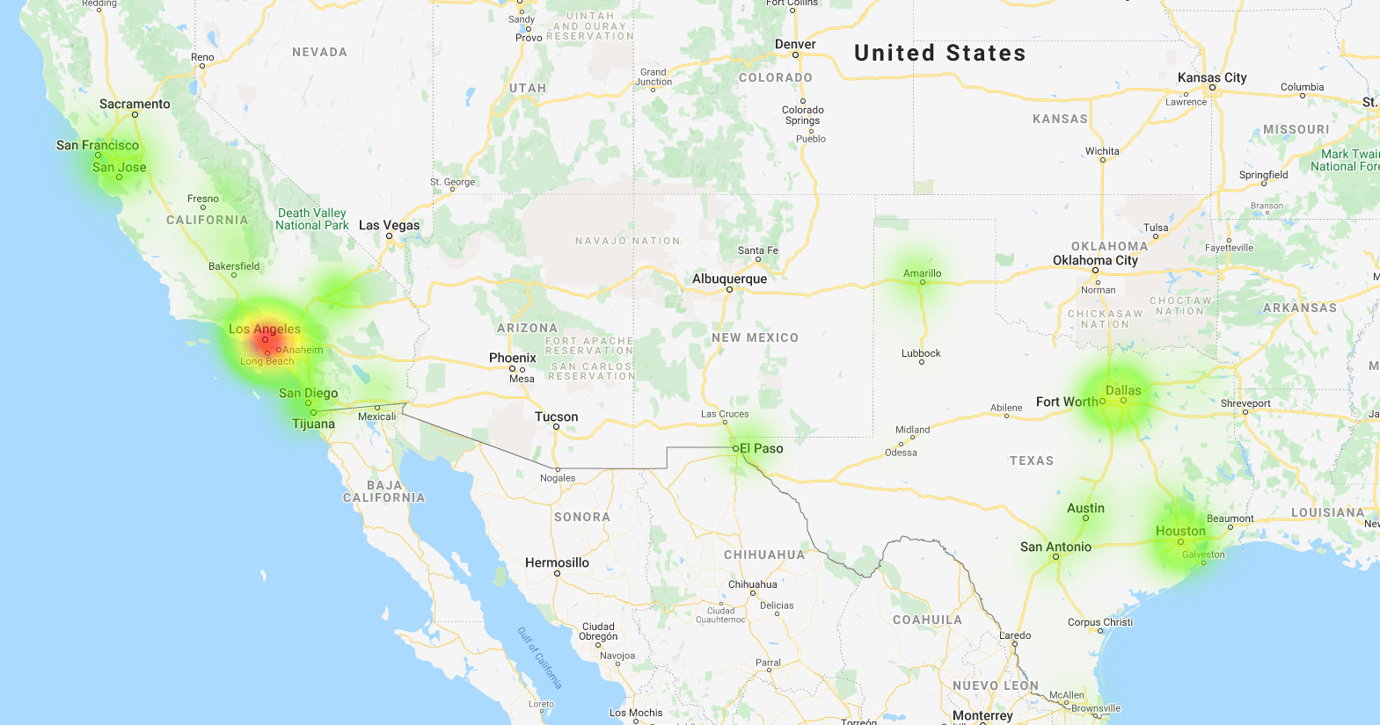
May 27, 2020

Slide 9
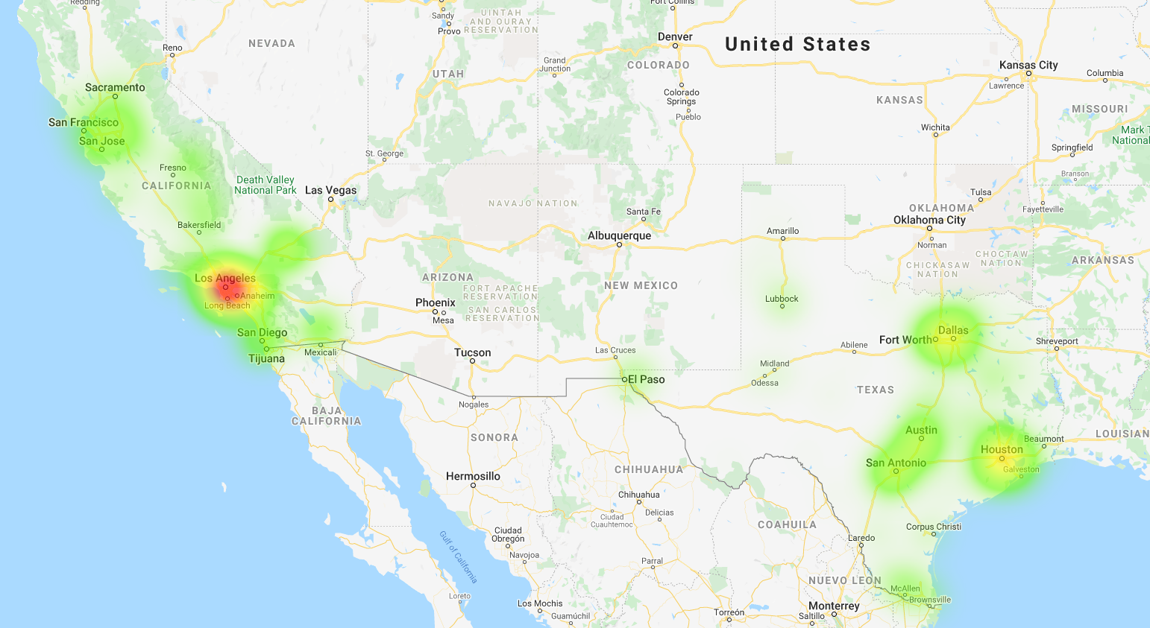
June 24, 2020

Slide 10
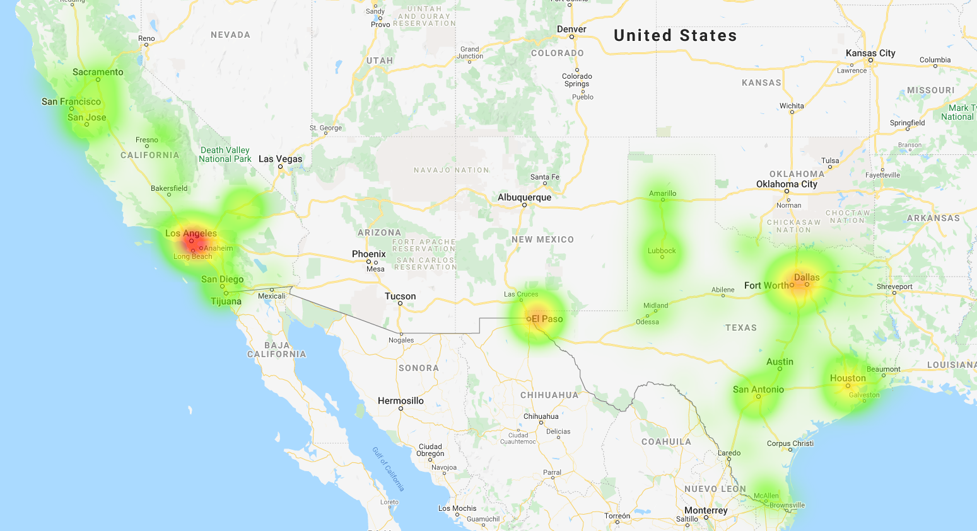
October 28, 2020

Slide 11
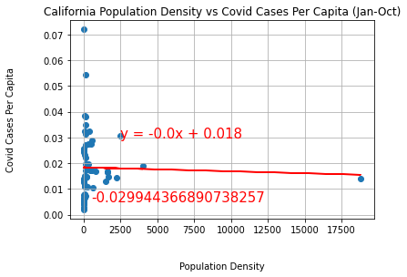
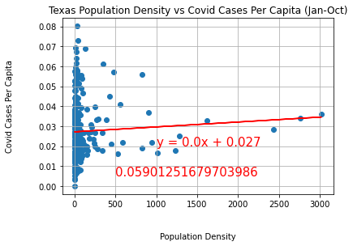
State | Population (million) | Difference in Population | Land Area (Sq. Mi.) | Difference in Land Area | People per Sq. Mi.
CA | 37 | CA 8 million more | 155,779 | TX 105K Sq. Mi. more | 254
TX | 29 |  | 261,267 |  | 105
San Francisco

Slide 12
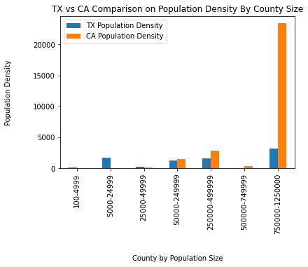
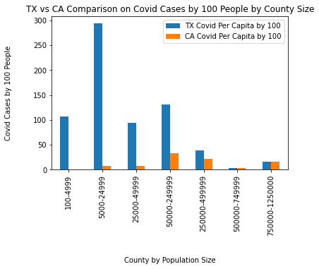
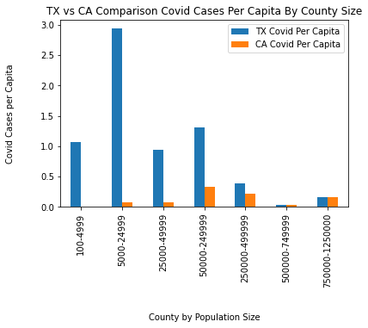
Counties by Population Size
Rural
Urban
Rural
Urban

Slide 13
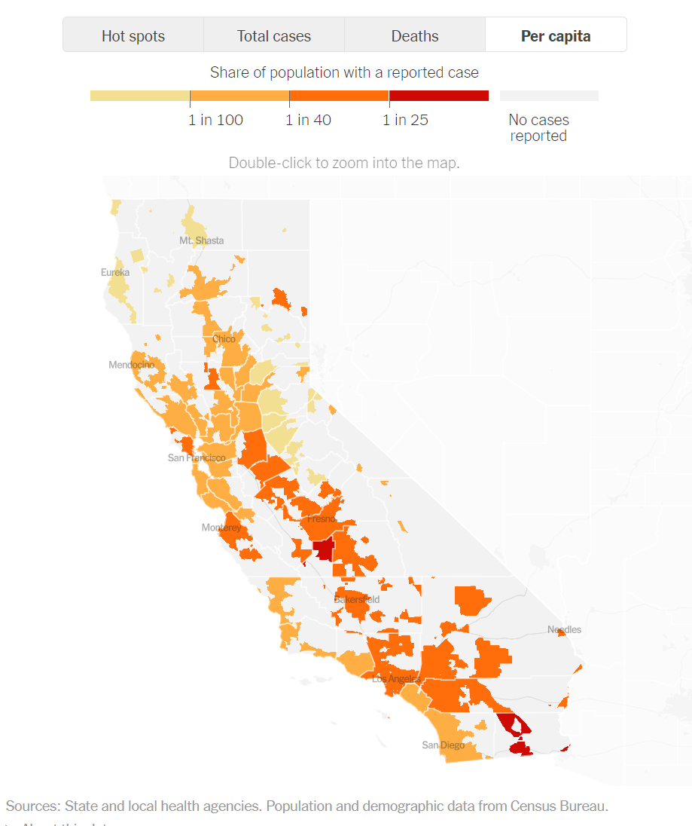
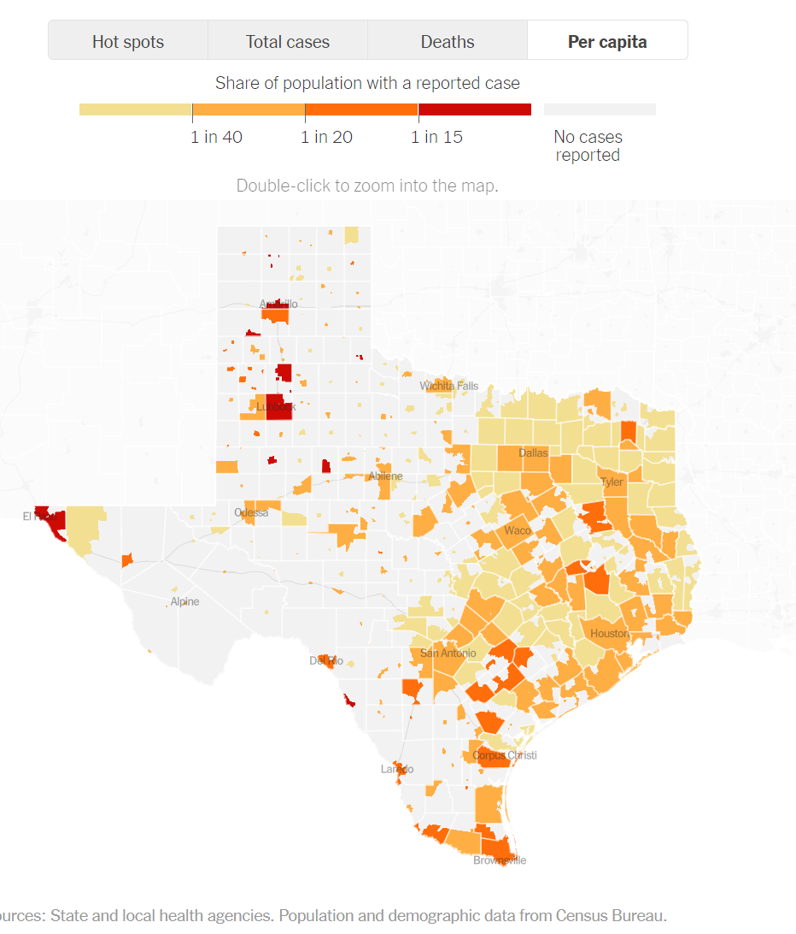
Codic19 Cases Per Capita, 11/8/2020

Slide 14


Limitations
Covid19 testing
Policy implementation and execution
Time constraints
Things we would do different next time
Include more states in the comparison
Compare to other country policies

Slide 15

Thank You
Questions?

